Slide 1


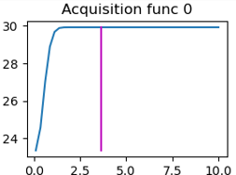
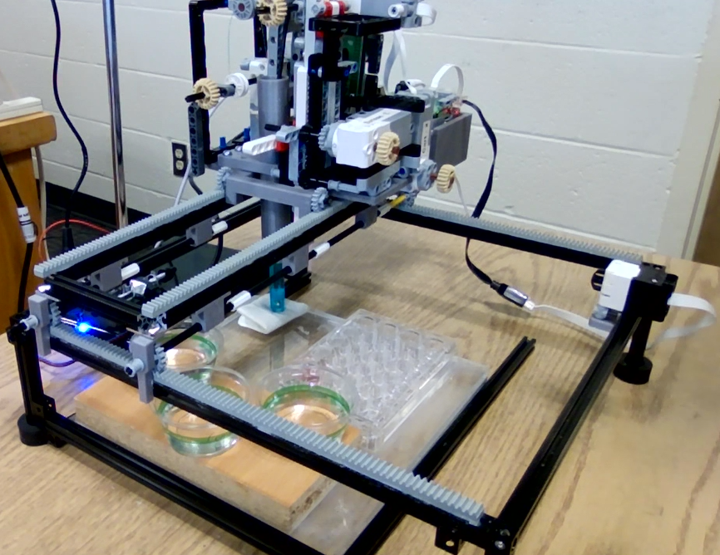
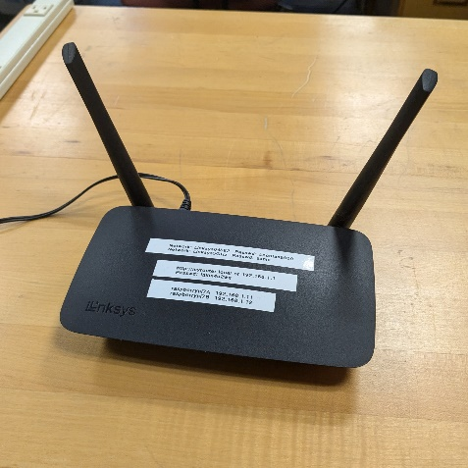
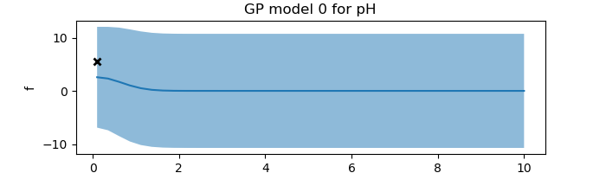
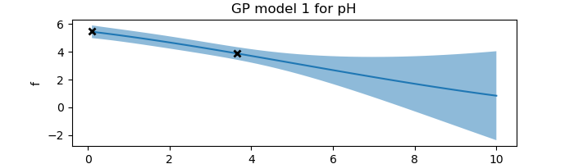
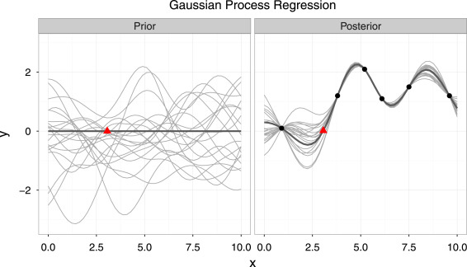
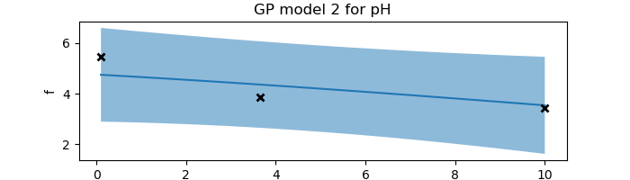
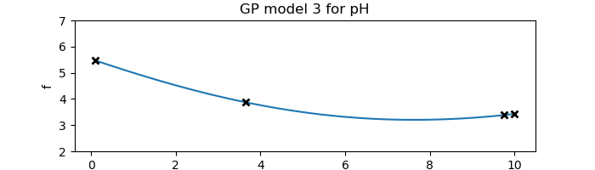
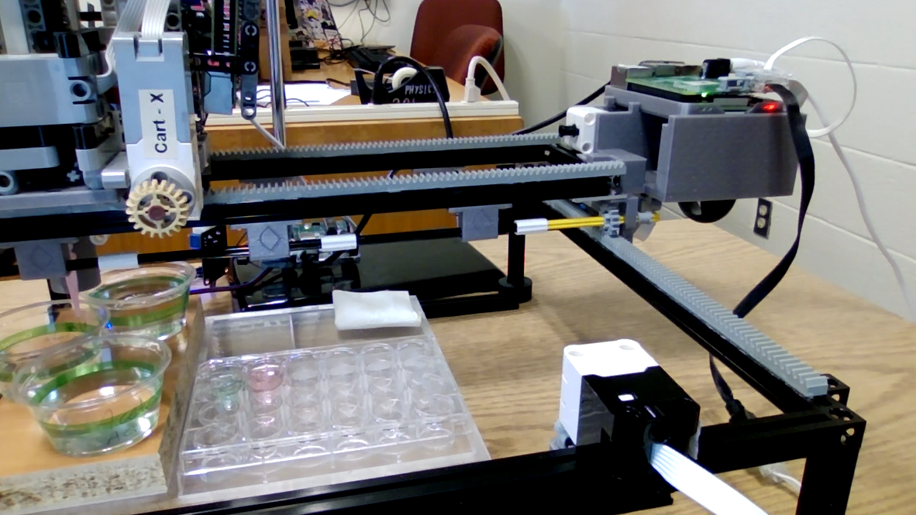
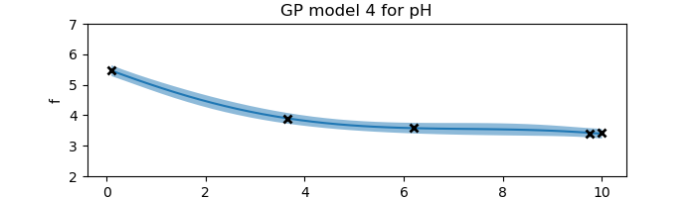
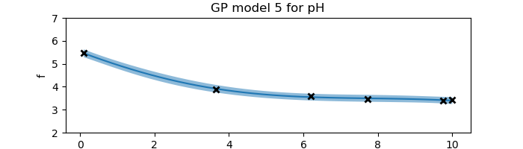
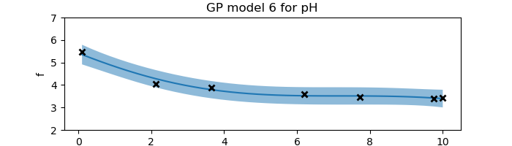
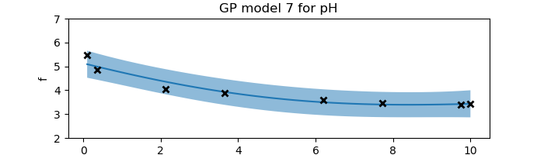
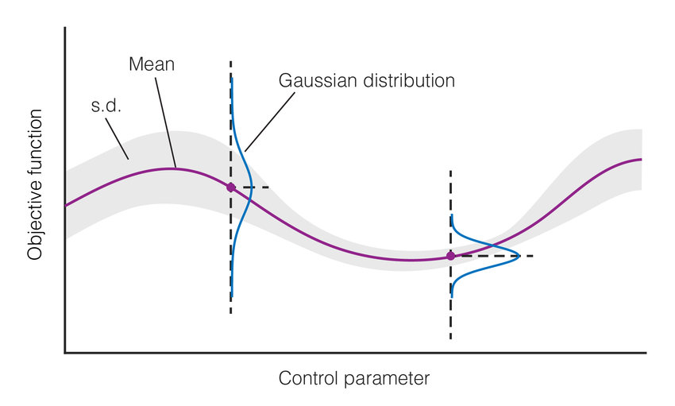
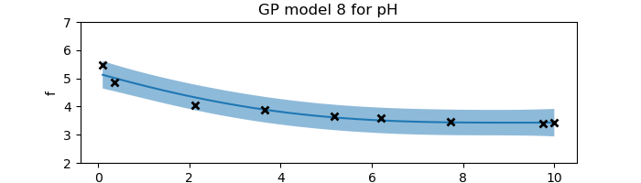

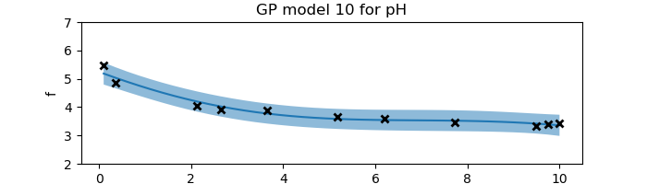
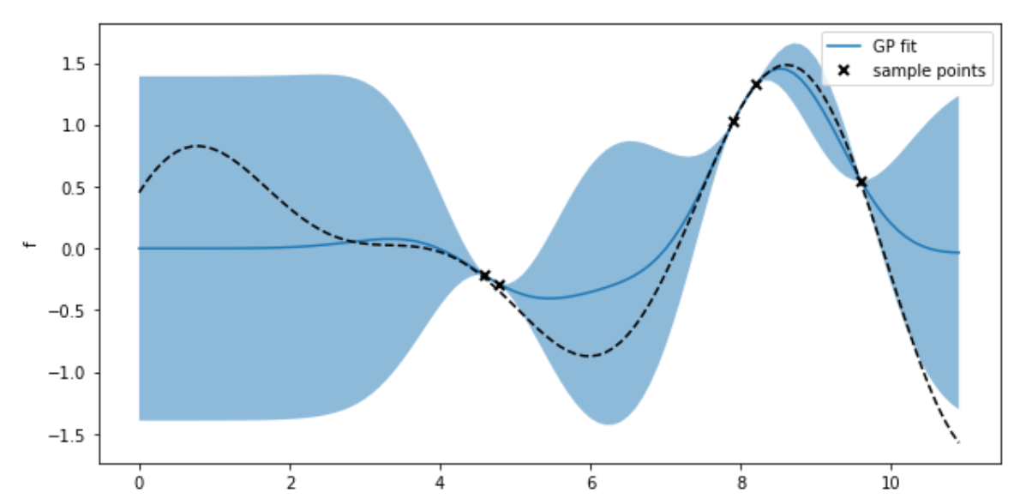
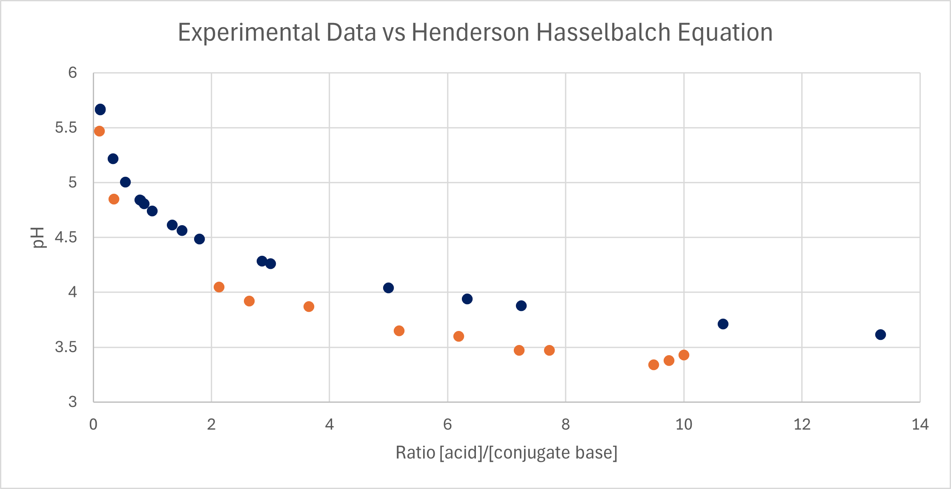
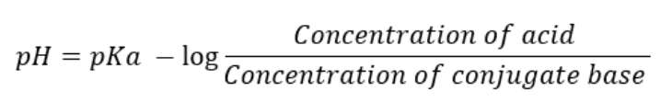
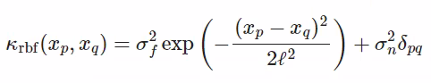
Automation and Machine Learning: How a Robot Can Conduct Its Own Experiments Using Gaussian Processes
Miller Gruen and Adi Timin
Advisor: Dr Mary Lowe, Physics Department, Loyola University Maryland
Introduction
Apparatus
Experimental Results
Computational Results
When scientists need to take large amounts of data, rather than taking countless measurements that take time, resources, and money, it may be better to automate the task. Beyond that, what if a device were able to do more than simply repeat a task, what if it could make its own decisions and conduct an experiment wholly without needing constant human supervision? We can accomplish this using Gaussian processes applied to machine learning.
Legolas possesses:
2 Raspberry Pis
1 Arduino
6 Lego Motors
1 pipette
1 pH sensor
The Raspberry Pis connect wirelessly to a computer running the code and run the Lego motors using a build hat to connect.
Add your information, graphs and images to this section.
Add your information, graphs and images to this section.
Theory and Background
Lego motor
Application and Importance
Water
(rinsing)
Raspberry Pi and Build Hat
Base
Limit switch
Acid
Standards
Experimental wells
The code is able to:
Establish communication between computer and pis
Functions for:
moving the motors in the x and y directions
Pipetting liquid
Moving pH sensor vertically
pH measurement
Cleaning and drying the pH sensor
GPy code
Function to establish RBF kernel
Function that does the regression
Function that uses active learning methods to determine the next data point to measure
Acknowledgements
Add your information, graphs and images to this section.
Henderson Hasselbalch Equation
Experimental data
References
Add your information, graphs and images to this section.

